Slide 1
Unsupervised Spam Detection
Use of unsupervised leaning methods to detect Spam in sms

Slide 2
Agenda
Why is this important
Data Collection
EDA
Data Preparation
Model training and evaluation
Discussion

Slide 3
Why is spam detection important
Spam is not always easy to detect
Humans can make misstakes, especially when stressed or distracted
Answer spam can cause severe damage

Slide 4



Data Collection
The dataset was collected by Tiago Almeida and Jos Hidalgo. They were contributing the data set to the following website: https://archive.ics.uci.edu/dataset/228/sms+spam+collection
Consists of 5572 SMS (747 spam/4825 ham)

Slide 5
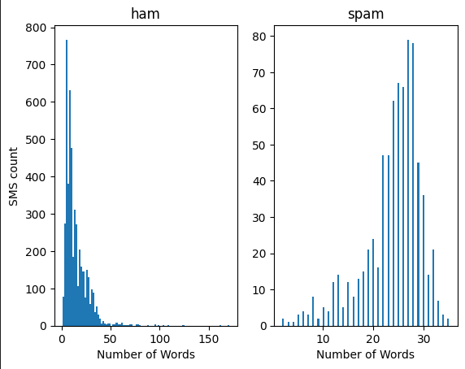
EDA
If a SMS extends more than 40 words it seems very unlikely that it is spam
However, there is no correlation between the word count of a SMS and wheater it is spam or not

Slide 6

Data Preparation
Replace labels ham and spam with 0 and 1
Use Tfidf vectorizer to convert text to feature matrix
Split the data in train and test set

Slide 7
Model building and training
Process:
GridSearchCV for hyperparameter tuning
Fit the data
Predict labels
Calculate Accuracy
Create Confusion Matrix
Models Used
Unsupervised:
Agglomerative Clustering
K-means Clustering
Supervised:
Logistic Regression

Slide 8
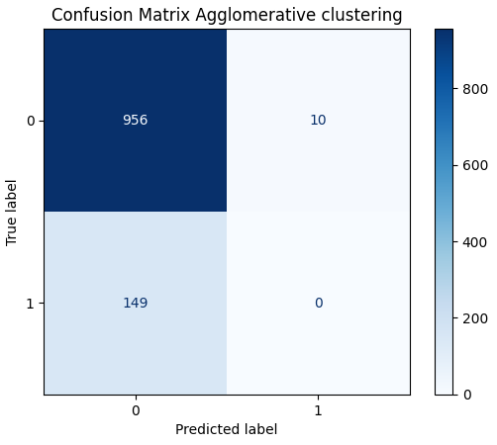
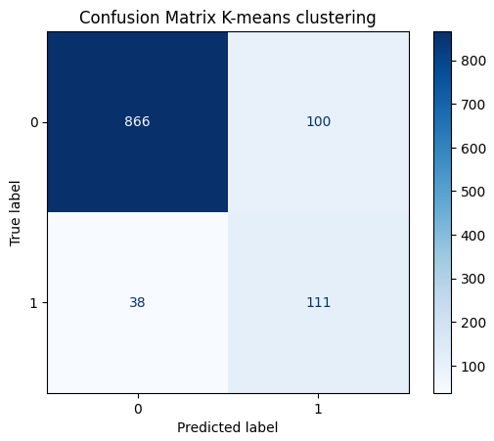
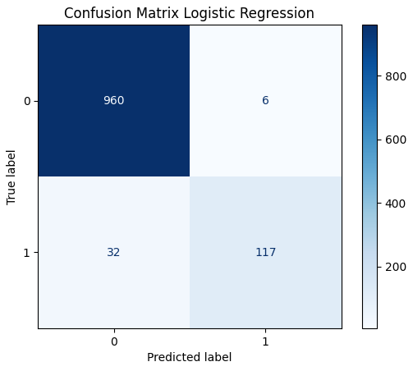
Results
ACC: 85.74%
ACC: 87.62%
ACC: 96.59%

Slide 9
Discussion
Agglomerative Clustering
K-means Clustering
Logistic regression
Did not detect any spam
Misslabled too much ham
=> Not suited for this case
Detected ¾ of the spam
Misslabled too much ham
=> Not suited for this case
Detected ¾ of the spam
Misslabled less than 1%
=> Best model so far

